Slide 1
Customer Support Chat Bot With ML
PIP2001 Capstone Project
Review-0
Batch Number: 168
STUDENT ROLL NO | STUDENT NAME
20211CSE0354 | NAVEEN KUMAR M
20211CSE0369 | MAHMADKAIP R SHIKKALAGAR
20211CSE0383 | MOHAN S G
20221LCS0013 | MADHU K
Under the Supervision of,
Mr Asad Mohammed Khan
Professor / Associate Professor / Assistant Professor
School of Computer Science and Engineering
Presidency University
Name of the Program: CSE
Name of the HoD: Dr.Asif Mohammed H.B
Name of the Program Project Coordinator: Mr. Amarnath J.L & Dr. Jayanthi. K.
Name of the School Project Coordinators: Dr. Sampath A K / Dr. Abdul Khadar A / Mr. Md Ziaur Rahman

Slide 2
Content
Problem Statement
Github Link
Analysis of Problem Statement
Timeline of the Project
References

Slide 3
Problem Statement Number:
Organization:
Category (Hardware / Software / Both) : Software
Problem Description: The organization aims to enhance its customer support system by developing a machine learning-powered chatbot that can handle customer queries in real-time. The chatbot should understand natural language, categorize inquiries, and provide accurate, relevant responses. It should also be able to escalate issues to human agents when necessary, ensuring a seamless transition.
Difficulty Level: Medium

Slide 4
Github Link
The Github link provided should have public access permission.
Github Link

Slide 5
Analysis of Problem Statement
Technology Stack Components:
React.js
2) Node.js
3) spaCy
4) Scikit-learn
5) MongoDB

Slide 6
Analysis of Problem Statement (contd...)
Software and Hardware Requirements:
Operating System
Programming Languages
Libraries and Frameworks
Database
Development Tools

Slide 7
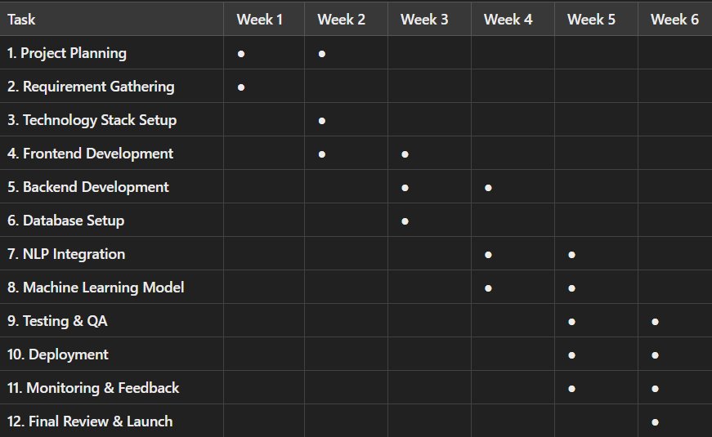
Timeline of the Project (Gantt Chart)

Slide 8
References (IEEE Paper format)
A. Kumar and P. Gupta, "Chatbot for Customer Support System Using AI and ML," International Journal of Advanced Research in Computer Science, vol. 9, no. 3, pp. 25-30, 2019.
J. Smith, "Natural Language Processing Techniques in Chatbots: A Comprehensive Survey," Journal of Artificial Intelligence Research, vol. 45, no. 2, pp. 112-120, May 2020.
S. Zhang and Y. Wang, "Improving Chatbot Interactions with Machine Learning," in Proceedings of the 11th IEEE International Conference on AI and ML Applications, 2021, pp. 45-50.
L. Davis, "An Overview of Machine Learning Algorithms for Chatbots," IEEE Access, vol. 7, pp. 123-140, 2020.

Slide 9
THANK YOU

